Slide 1
How the world wide web works
Who invented the internet?
Who invented the world wide web?

Slide 2
http://truro-penwith.ac.uk
What happens?

Slide 3
DNS
IP address
HTTP traffic to IP Address (GET or POST etc)
Apache sniffing 80 or 443
Deals with request

Slide 4
Other things going on:
Apache -> PHP
PHP (usually Laravel or Zend Framework or similar – design patterns, MVD, ORM)
SQL
View templating and caching
HTML
CSS (sass, scss)
Js (jQuery or Vue or React)
Assets “compiled”

Slide 5
Ajax – js and json (not HTML)
API requests (json or XML)
B2B (XML usually)
Database sharding, replication, read-only, caching

Slide 6
Today - XampP
Install XAMPP
Install VSCode
http://localhost
http://127.0.0.1
(there’s no place like home)

Slide 7

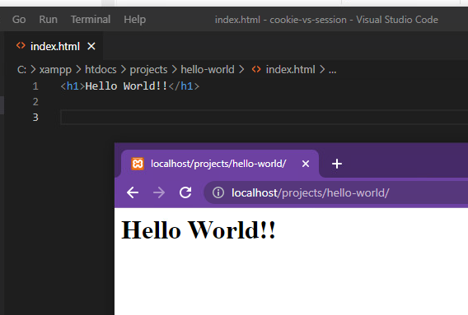
Create a hello world webpage
Create the above folder structure ( projects/hello-world )
Open VSCode
Add a new file called index.html

Slide 8
Make a pretty webpage
You have a portfolio page from earlier in the year
Try to browse to each others portfolios

